Slide 1
Night vision
On a dark night a car is driving away from you.
You watch as its lights get dimmer and dimmer.
UY 18 SEG
UY 18 SEG

Slide 2
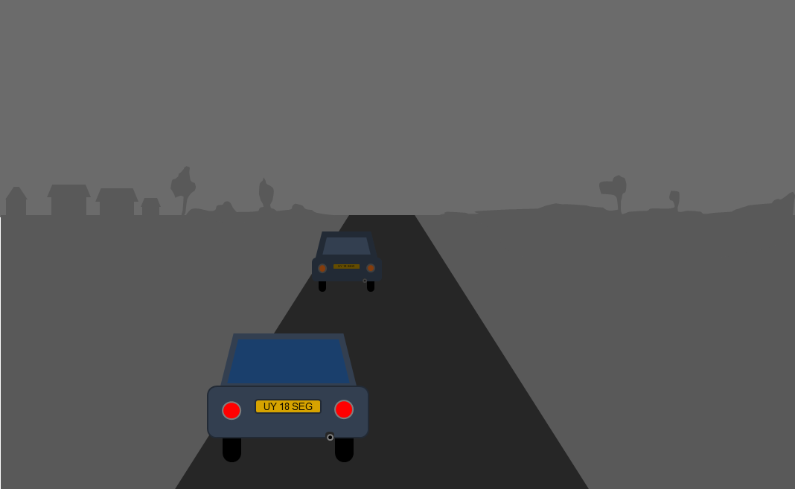
Night vision
Why do the lights get dimmer as the car drives away?
A
Light spreads out so less of it reaches your eyes
B
Light gets weaker as it travels
C
Your eyes can only see short distances in the dark
D
Light can only travel a short distance

Slide 3
Night vision
On a dark night a cyclist is coming towards you.
You watch as the light gets brighter and brighter.

Slide 4
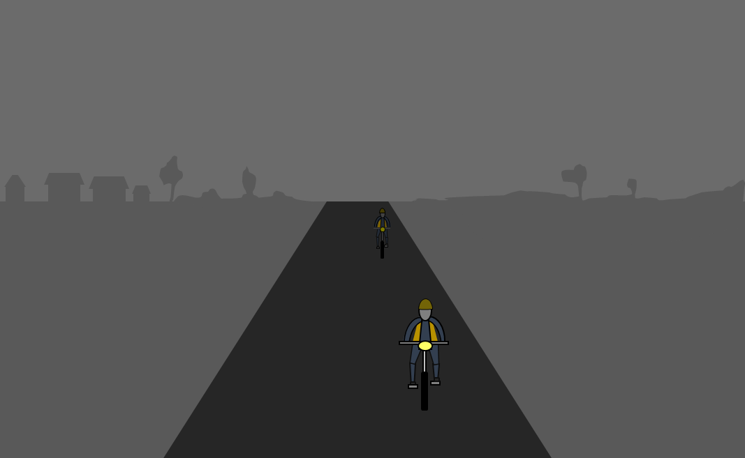
Night vision
Why does the light get brighter as the bike gets closer?
A
It is easier for the light to reach you
B
Light has spread out less so more of it reaches your eyes
C
There is less darkness to see through
D
The light has not travelled as far

